Slide 1
Artificial Intelligence CS-202
Topic: Game Playing and Adversarial Search
Habiba Arshad
Department of Computer Science
University of Wah

Slide 2
Week-5 CLO
This week lecture will cover the following CLO’s:
CLO1: Discuss the key concepts in the field of artificial intelligence
CLO 2: Implement artificial intelligence techniques and case studies

Slide 3
CLO’s Mapping
CLO 1:
Introduction
Game Playing in AI
Adversarial Search and the Minimax Algorithm
Cut-Off Search
Pruning Techniques (including Alpha-Beta Pruning)
CLO 2:
Implement
Adversarial Search and the Minimax Algorithm
Alpha-Beta Pruning
Case Studies: Chess and Checkers

Slide 4
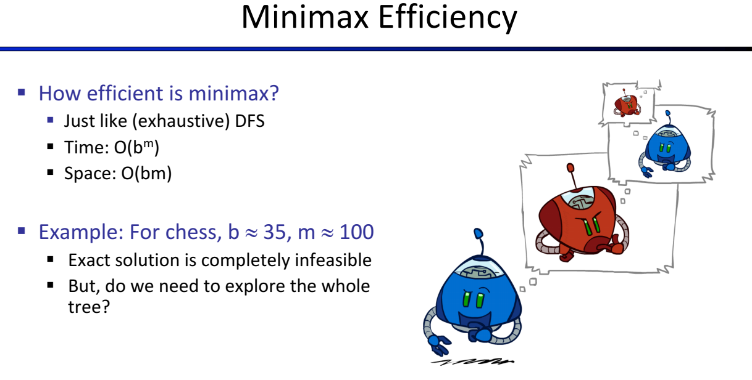

Slide 5
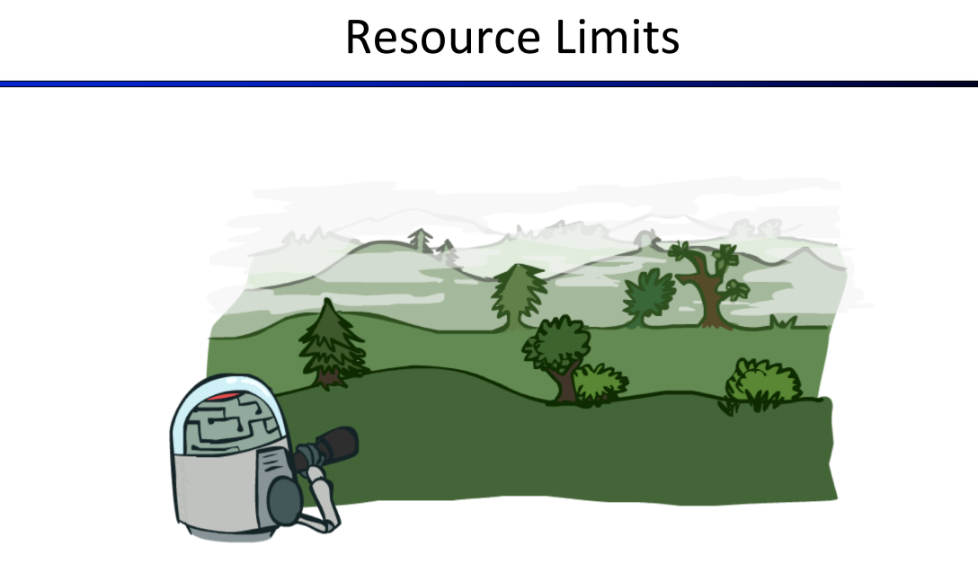

Slide 6
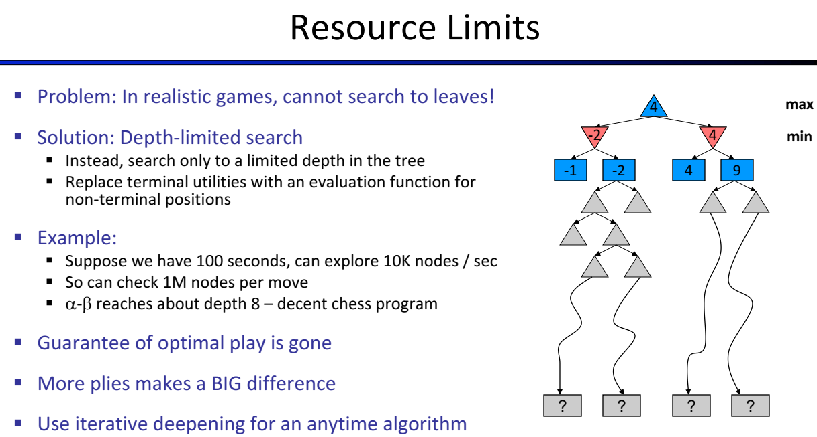

Slide 7
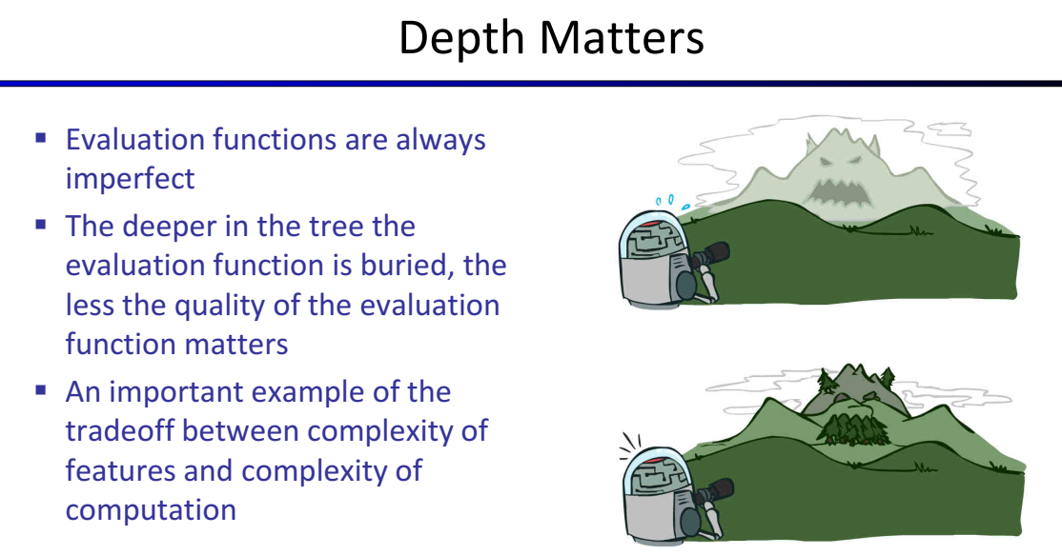

Slide 8
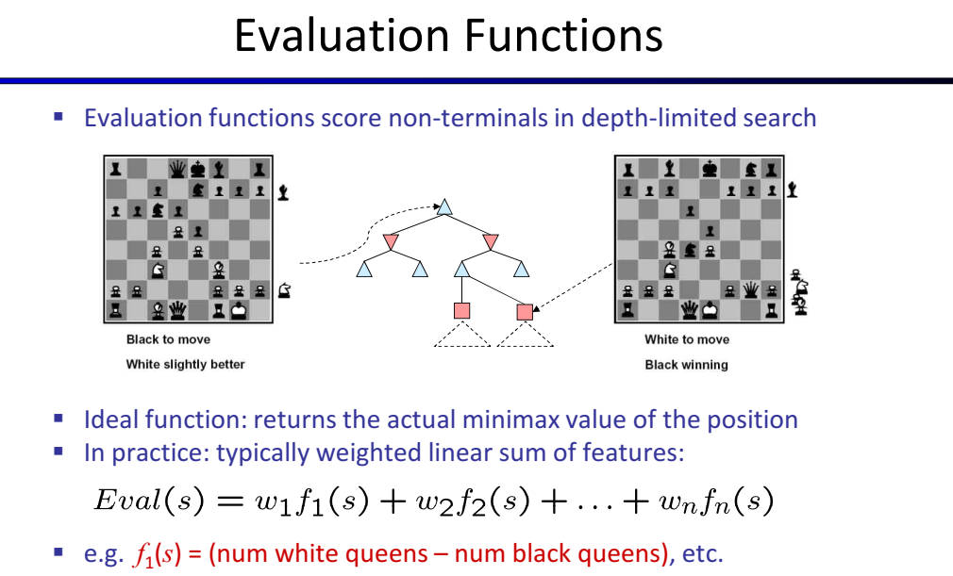

Slide 9
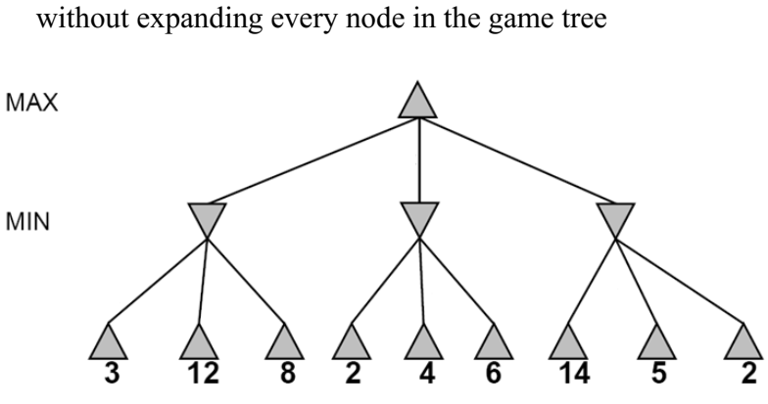
Notes:
MinMax Time Complexity O(b^d) as we have to explore all nodes

Slide 10
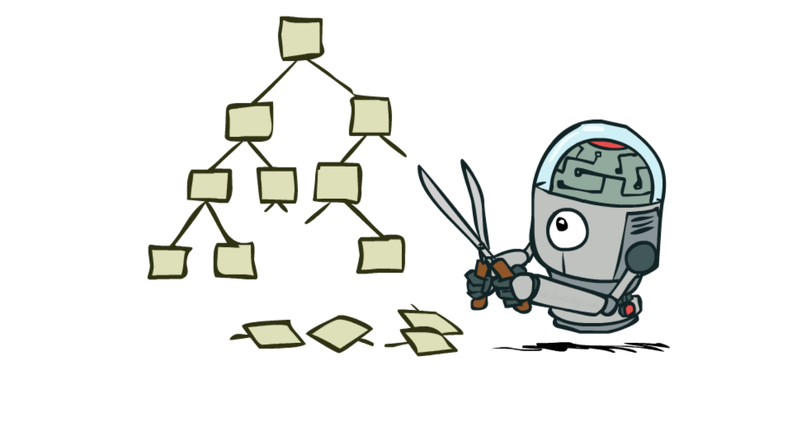

Slide 11
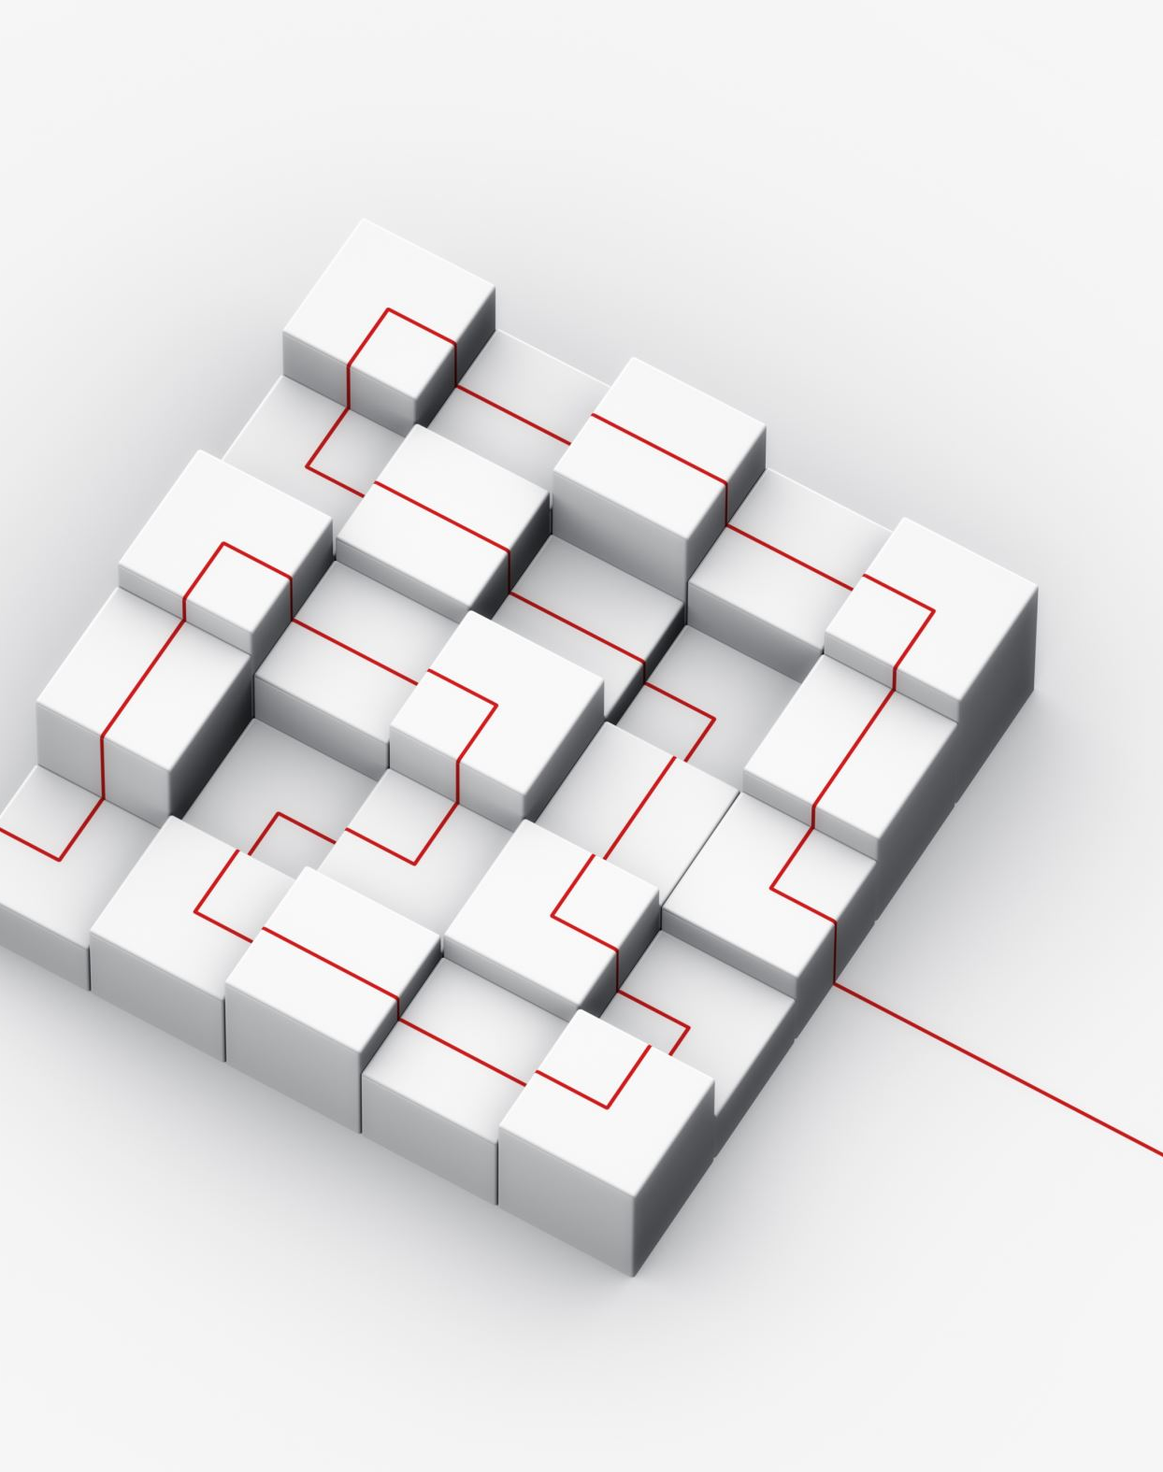
Alpha-Beta Pruning
An optimization technique/ modified version of the minimax algorithm.
We cannot eliminate the exponential expansion of minimax, but we can cut it to half using pruning technique
A technique by which without checking each node of the game tree we can compute the correct minimax decision
Pruning makes the algorithm fast, as sometimes it not only prunes the leaves but also entire sub-tree that is not really affecting the final decision but making algorithm slow

Slide 12
Contd..
Involves two threshold parameter Alpha and beta for future expansion, so name alpha-beta pruning/Algo.
The two-parameter can be defined as:
Alpha: The best (highest-value) choice we have found so far at any point along the path of Maximizer. The initial value of alpha is -∞.
Beta: The best (lowest-value) choice we have found so far at any point along the path of Minimizer. The initial value of beta is +∞.
Cut off search by exploring less no of nodes
If a best path is found, remaining paths are not explored instead we cut off them

Slide 13
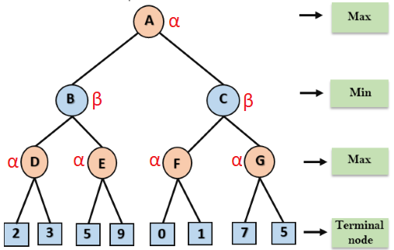
Example
Step 1: At the first step the, Max player will start first move from node A (Max), will move downwards to B->D and terminal node and find α and β values using utility values.

Slide 14
Contd..
Step 2: at node D, left value of 2 will be assigned to α. Now it’s mean that value of D will be ≥ 2 as its max turn. Now check other node that has value of 3 and it is turn of Max, so α value be updated with 3 and D node will have value of 3.
Step 3: now at node B, assign value of node D to β at node B. as its min turn its mean node B will have value ≤ 3.
After that, next successor E will be traversed which will get value of α=5 from left leaf of E. as it’s max turn, its mean that node E will have value of ≥ 5, where as node B already have a minimum value of 3. So, there is no need to traverse the other successor of E and hence pruned.

Slide 15
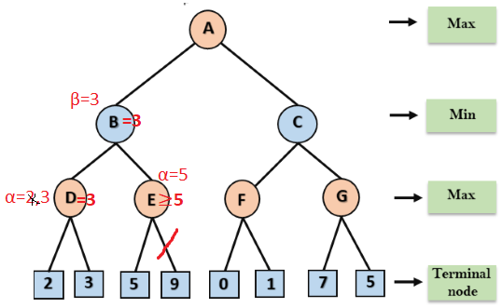
Contd..

Slide 16
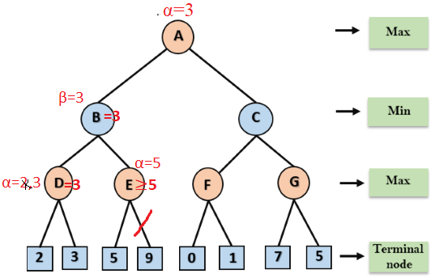
Contd..
Step 4: now at node A, α will get value of 3. as its turn of max, so value of A will be ≥ 3.
Here any other path that will give value less than 3 will be pruned.

Slide 17
Contd..
Step 5:Now, node C from right side will be traversed, which will go downward to F and F will get value of 0 for α. As it s turn of Max so value for F will be ≥ 0. right successor of F has value 1, so α value be updated with 1 and F will get max value of 1.
Step 6: F will return value of 1 to β at node C. as its turn of Min and value of C will be ≤ 1, whereas node A already has max value of 3, so another value generated after traversing nodes further will return value ≤ 1. Therefore, no need to explore further and right complete branch of C will be pruned.
A will retain utility value of 3 i.e. optimal value for maximizer.

Slide 18
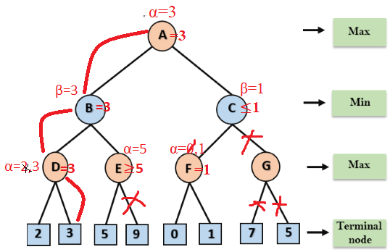
Contd..
So, if max follows A->B->D->I, it will definitely win with the utility of 3.
Notes:
So, alpha beta algorithm is much efficient than minmax.

Slide 19
Complexity
Complexity is dependent on traversal ordering of nodes. It can be of two types:
Worst ordering
In some cases, alpha-beta pruning algorithm does not prune any of the leaves of the tree, and works exactly as minimax algorithm.
In this case, the best move occurs on the right side of the tree and it also consumes more time because of alpha-beta factors.
The time complexity for such an order is O(b^{d}).
Ideal ordering:
The ideal ordering for alpha-beta pruning occurs when lots of pruning happens in the tree, and best moves occur at the left side of the tree.
We apply DFS hence, it first search left of the tree and go deep twice as minimax algorithm in the same amount of time.
Complexity in ideal ordering is O(b^{d/2}).

Slide 20
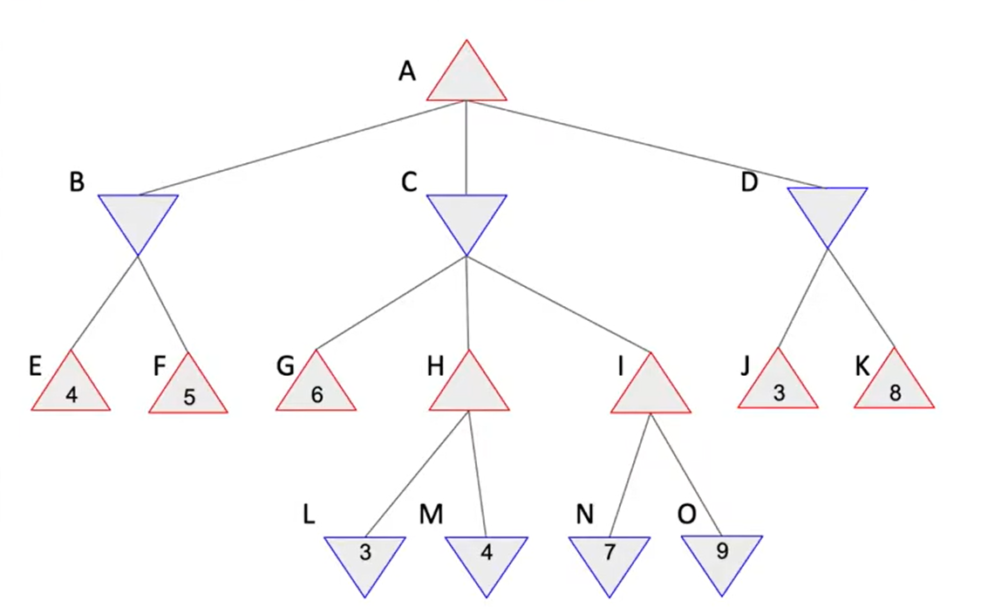
Task Alpa – Beta Pruning

Slide 21
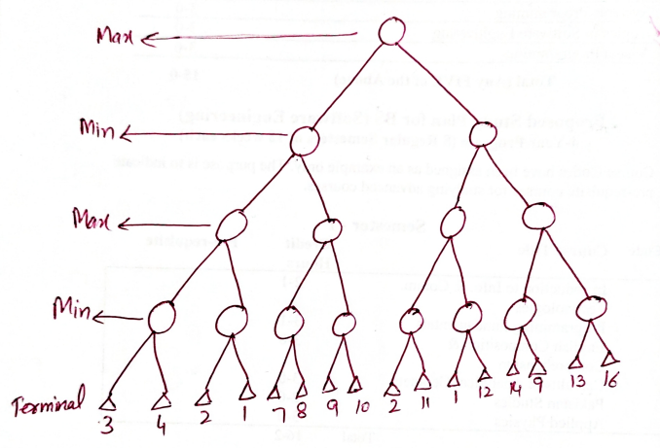
Task
Find the best path and optimal value for Max using alpha-beta pruning.

